Slide 1
Chapter 10
Sorting Algorithms
- rearranging a list of numbers into increasing (strictly nondecreasing) order. (a fundamental operation that appears in many applications. )
Slides for Parallel Programming Techniques & Applications Using Networked Workstations & Parallel Computers 2nd ed., by B. Wilkinson & M. Allen, @ 2004 Pearson Education Inc. All rights reserved.

Slide 2
Preliminary Chapters
Two sorting algorithms have already been presented to demonstrate specific parallelizing techniques.
  Bucket sort demonstrated divide and conquer in Chapter 4
  insertion sort demonstrated a pipeline in Chapter 5
synchronous algorithms, in that a group of actions taking place on the numbers must be completed before the next group of actions takes place.
Slides for Parallel Programming Techniques & Applications Using Networked Workstations & Parallel Computers 2nd ed., by B. Wilkinson & M. Allen, @ 2004 Pearson Education Inc. All rights reserved.

Slide 3
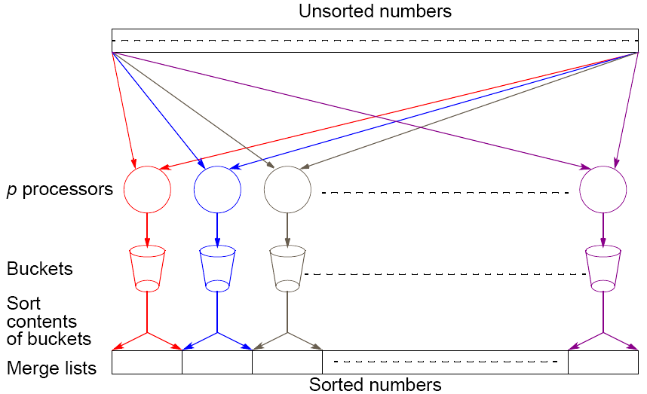
Slides for Parallel Programming Techniques & Applications Using Networked Workstations & Parallel Computers 2nd ed., by B. Wilkinson & M. Allen, @ 2004 Pearson Education Inc. All rights reserved.

Slide 4
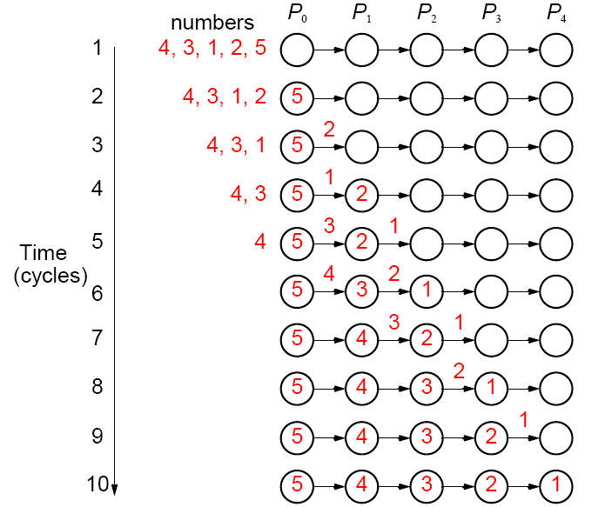
A parallel version of insertion sort.
Slides for Parallel Programming Techniques & Applications Using Networked Workstations & Parallel Computers 2nd ed., by B. Wilkinson & M. Allen, @ 2004 Pearson Education Inc. All rights reserved.

Slide 5

Potential Speedup
O(nlogn) optimal for any sequential sorting algorithm without using special properties of the numbers.
Best we can expect based upon a sequential sorting algorithm using n processors is
Has been obtained but the constant hidden in the order notation extremely large.
Slides for Parallel Programming Techniques & Applications Using Networked Workstations & Parallel Computers 2nd ed., by B. Wilkinson & M. Allen, @ 2004 Pearson Education Inc. All rights reserved.

Slide 6
Quicksort and mergesort are popular sequential sorting algorithms. They are in the family of "comparison-based" sorting algorithms that sort only on the basis of comparing pairs of numbers.
Slides for Parallel Programming Techniques & Applications Using Networked Workstations & Parallel Computers 2nd ed., by B. Wilkinson & M. Allen, @ 2004 Pearson Education Inc. All rights reserved.

Slide 7
Compare-and-Exchange Sorting Algorithms
Compare and Exchange
Form the basis of several, if not most, classical sequential sorting algorithms.
Two numbers, say A and B, are compared. If A > B, A and B are exchanged, i.e.:
if (A > B) {
temp = A;
A = B;
B = temp;
}
Slides for Parallel Programming Techniques & Applications Using Networked Workstations & Parallel Computers 2nd ed., by B. Wilkinson & M. Allen, @ 2004 Pearson Education Inc. All rights reserved.

Slide 8
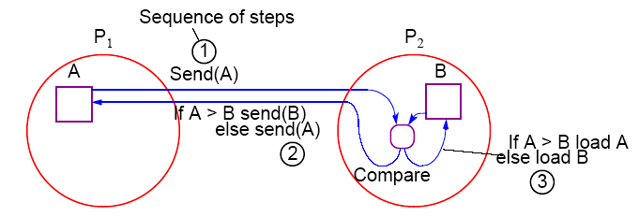
Message-Passing Compare and Exchange
Version 1
P₁ sends A to P₂, which compares A and B and sends back B to P₁ if A is larger than B (otherwise it sends back A to P₁):
Slides for Parallel Programming Techniques & Applications Using Networked Workstations & Parallel Computers 2nd ed., by B. Wilkinson & M. Allen, @ 2004 Pearson Education Inc. All rights reserved.

Slide 9
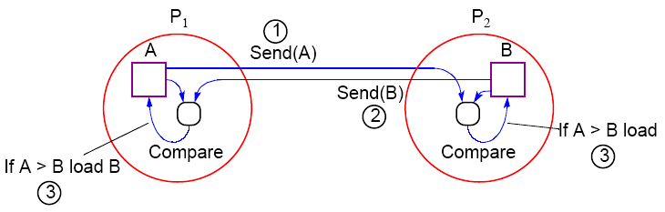
Alternative Message Passing Method
Version 2
For P₁ to send A to P₂ and P₂ to send B to P₁. Then both processes perform compare operations. P₁ keeps the larger of A and B and P₂ keeps the smaller of A and B:
Slides for Parallel Programming Techniques & Applications Using Networked Workstations & Parallel Computers 2nd ed., by B. Wilkinson & M. Allen, @ 2004 Pearson Education Inc. All rights reserved.

Slide 10
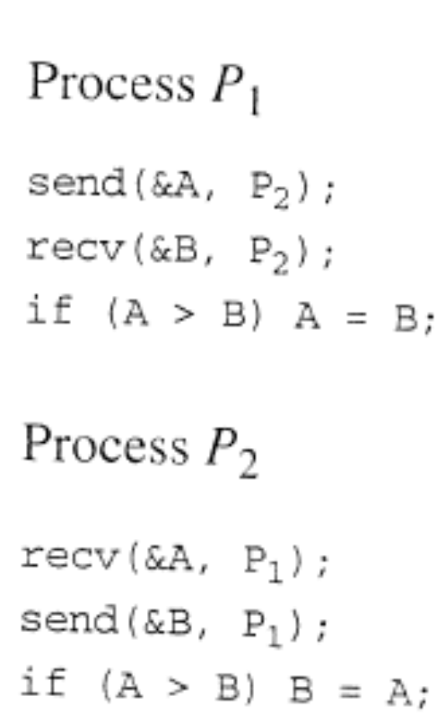
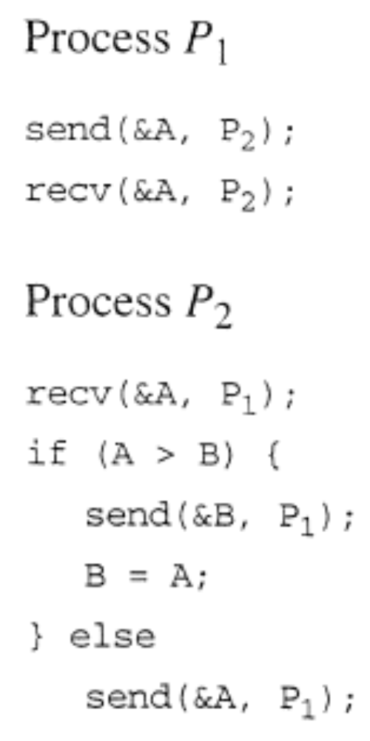
Version 2
Version 1
Slides for Parallel Programming Techniques & Applications Using Networked Workstations & Parallel Computers 2nd ed., by B. Wilkinson & M. Allen, @ 2004 Pearson Education Inc. All rights reserved.

Slide 11
Note on Precision of Duplicated Computations
Previous code assumes that the if condition, A > B, will return the same Boolean answer in both processors.
Different processors operating at different precision could conceivably produce different answers if real numbers are being compared.
This situation applies to anywhere computations are duplicated in different processors to reduce message passing, or to make the code SPMD.
Slides for Parallel Programming Techniques & Applications Using Networked Workstations & Parallel Computers 2nd ed., by B. Wilkinson & M. Allen, @ 2004 Pearson Education Inc. All rights reserved.

Slide 12
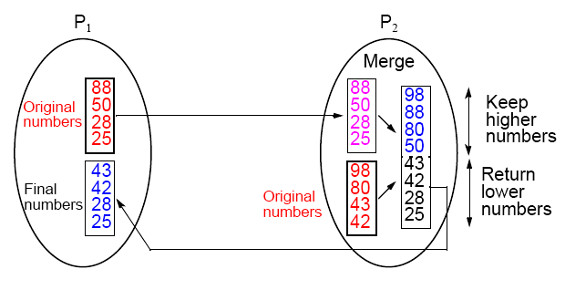
Data Partitioning
(Version 1)
p processors and n numbers. n/p numbers assigned to each
processor:
Slides for Parallel Programming Techniques & Applications Using Networked Workstations & Parallel Computers 2nd ed., by B. Wilkinson & M. Allen, @ 2004 Pearson Education Inc. All rights reserved.

Slide 13
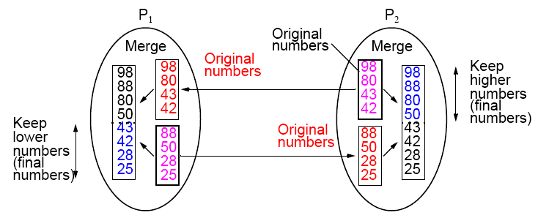
Merging Two Sublists — Version 2
Merging two sorted lists is a common operation in sorting algorithms.
Slides for Parallel Programming Techniques & Applications Using Networked Workstations & Parallel Computers 2nd ed., by B. Wilkinson & M. Allen, @ 2004 Pearson Education Inc. All rights reserved.

Slide 14
Bubble Sort
First, largest number moved to the end of list by a series of
compares and exchanges, starting at the opposite end.
Actions repeated with subsequent numbers, stopping just before the previously positioned number.
In this way, the larger numbers move (“bubble”) toward one end,
Slides for Parallel Programming Techniques & Applications Using Networked Workstations & Parallel Computers 2nd ed., by B. Wilkinson & M. Allen, @ 2004 Pearson Education Inc. All rights reserved.

Slide 15
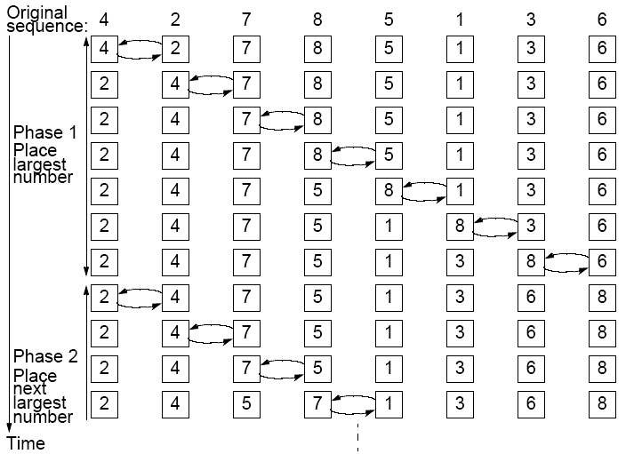
Slides for Parallel Programming Techniques & Applications Using Networked Workstations & Parallel Computers 2nd ed., by B. Wilkinson & M. Allen, @ 2004 Pearson Education Inc. All rights reserved.

Slide 16

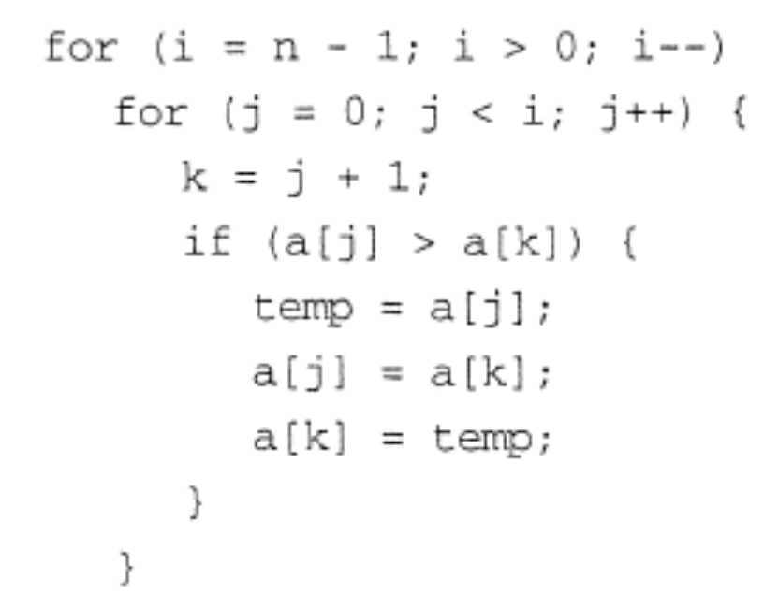
Time Complexity
Number of compare and exchange operations
Indicates a time complexity of O(n²) given that a single compare-and- exchange operation has a constant complexity, O(1).
Slides for Parallel Programming Techniques & Applications Using Networked Workstations & Parallel Computers 2nd ed., by B. Wilkinson & M. Allen, @ 2004 Pearson Education Inc. All rights reserved.

Slide 17
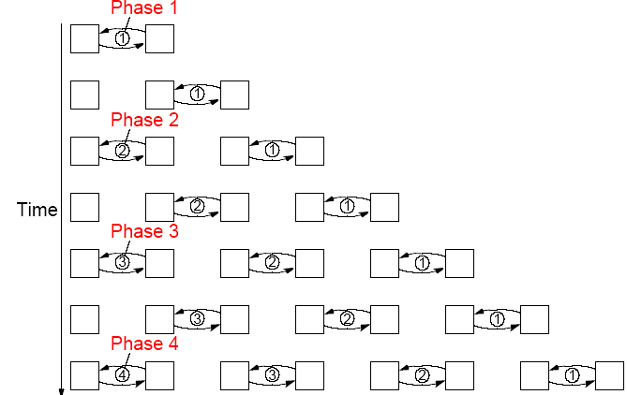
Parallel Bubble Sort
Iteration could start before previous iteration finished if does not overtake previous bubbling action: (pipeline)
Slides for Parallel Programming Techniques & Applications Using Networked Workstations & Parallel Computers 2nd ed., by B. Wilkinson & M. Allen, @ 2004 Pearson Education Inc. All rights reserved.

Slide 18
Odd-Even (Transposition) Sort
Variation of bubble sort.
Operates in two alternating phases, even phase and odd phase.
Even phase
Even-numbered processes exchange numbers with their right neighbor.
Odd phase
Odd-numbered processes exchange numbers with their right neighbor.
Slides for Parallel Programming Techniques & Applications Using Networked Workstations & Parallel Computers 2nd ed., by B. Wilkinson & M. Allen, @ 2004 Pearson Education Inc. All rights reserved.

Slide 19
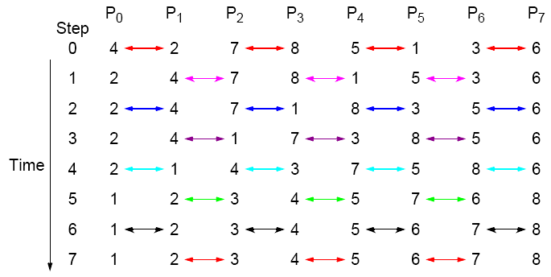
Odd-Even Transposition Sort
Sorting eight numbers
Slides for Parallel Programming Techniques & Applications Using Networked Workstations & Parallel Computers 2nd ed., by B. Wilkinson & M. Allen, @ 2004 Pearson Education Inc. All rights reserved.

Slide 20

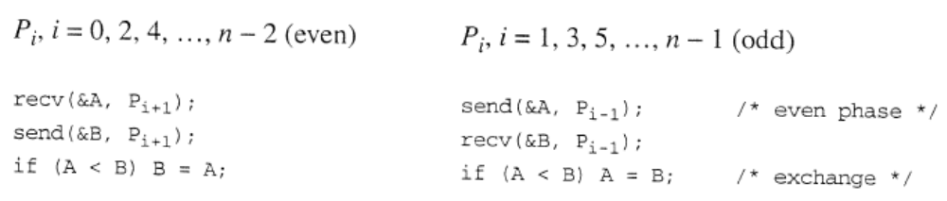

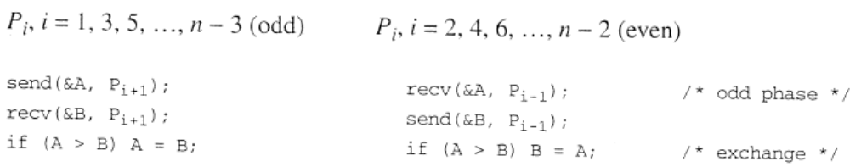
Even phase
Odd phase
Slides for Parallel Programming Techniques & Applications Using Networked Workstations & Parallel Computers 2nd ed., by B. Wilkinson & M. Allen, @ 2004 Pearson Education Inc. All rights reserved.

Slide 21
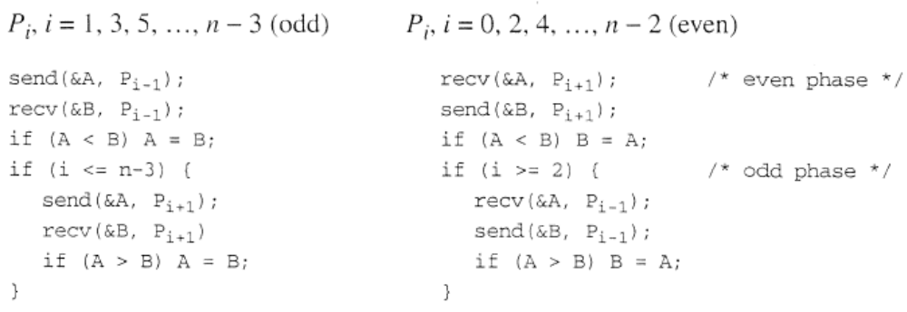
Slides for Parallel Programming Techniques & Applications Using Networked Workstations & Parallel Computers 2nd ed., by B. Wilkinson & M. Allen, @ 2004 Pearson Education Inc. All rights reserved.

Slide 22
Mergesort
A classical sequential sorting algorithm using divide-and-conquer approach. Unsorted list first divided into half. Each half is again divided into two. Continued until individual numbers are obtained.
Then pairs of numbers combined (merged) into sorted list of two numbers. Pairs of these lists of four numbers are merged into sorted lists of eight numbers. This is continued until the one fully sorted list is obtained.
Slides for Parallel Programming Techniques & Applications Using Networked Workstations & Parallel Computers 2nd ed., by B. Wilkinson & M. Allen, @ 2004 Pearson Education Inc. All rights reserved.

Slide 23
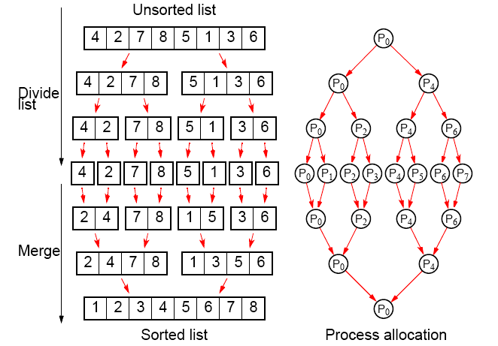
Parallelizing Mergesort
Using tree allocation of processes
Slides for Parallel Programming Techniques & Applications Using Networked Workstations & Parallel Computers 2nd ed., by B. Wilkinson & M. Allen, @ 2004 Pearson Education Inc. All rights reserved.

Slide 24
Analysis
Sequential
Sequential time complexity is O(nlogn).
Parallel
2 log n steps in the parallel version but each step may need to perform more than one basic operation, depending upon the number of numbers being processed.
Slides for Parallel Programming Techniques & Applications Using Networked Workstations & Parallel Computers 2nd ed., by B. Wilkinson & M. Allen, @ 2004 Pearson Education Inc. All rights reserved.

Slide 25
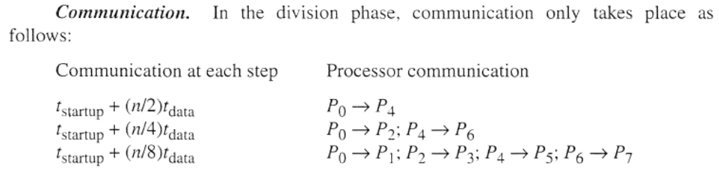
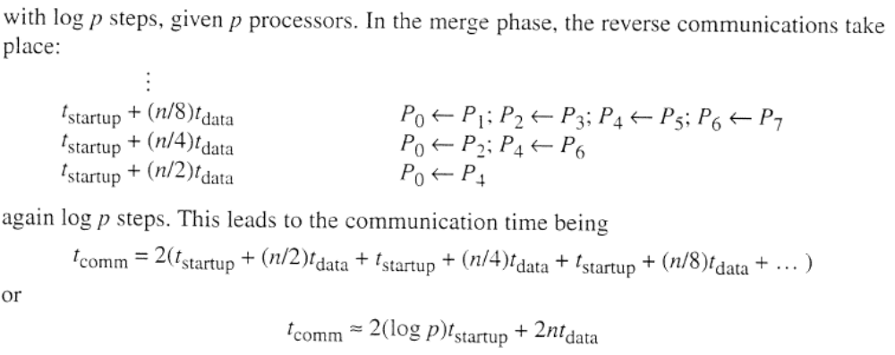
Slides for Parallel Programming Techniques & Applications Using Networked Workstations & Parallel Computers 2nd ed., by B. Wilkinson & M. Allen, @ 2004 Pearson Education Inc. All rights reserved.

Slide 26


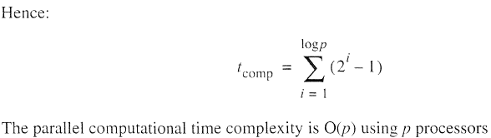
Slides for Parallel Programming Techniques & Applications Using Networked Workstations & Parallel Computers 2nd ed., by B. Wilkinson & M. Allen, @ 2004 Pearson Education Inc. All rights reserved.

Slide 27
Quicksort
Very popular sequential sorting algorithm that performs well with average sequential time complexity of O(nlogn).
First list divided into two sublists. All numbers in one sublist arranged to be smaller than all numbers in other sublist.
Achieved by first selecting one number, called a pivot, against which every other number is compared. If the number is less than the pivot, it is placed in one sublist. Otherwise, it is placed in the other sublist.
Pivot could be any number in the list, but often first number in list chosen. Pivot itself could be placed in one sublist, or the pivot could be separated and placed in its final position.
Slides for Parallel Programming Techniques & Applications Using Networked Workstations & Parallel Computers 2nd ed., by B. Wilkinson & M. Allen, @ 2004 Pearson Education Inc. All rights reserved.

Slide 28
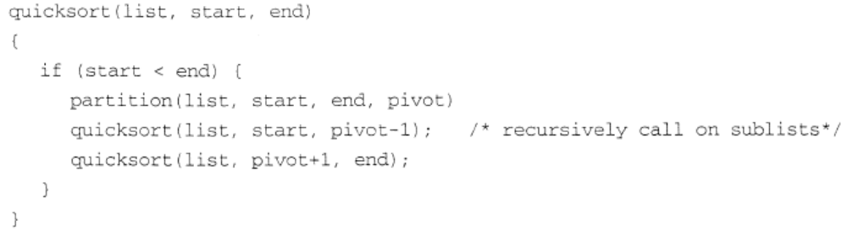
Slides for Parallel Programming Techniques & Applications Using Networked Workstations & Parallel Computers 2nd ed., by B. Wilkinson & M. Allen, @ 2004 Pearson Education Inc. All rights reserved.

Slide 29
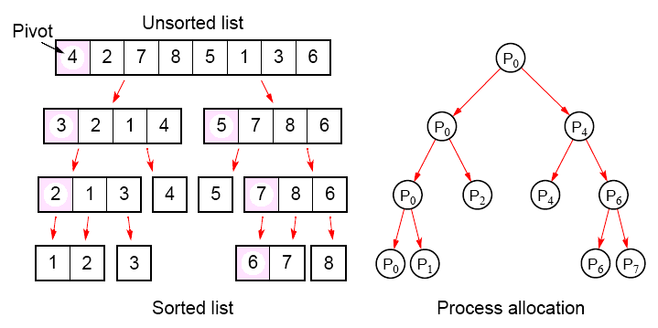
Parallelizing Quicksort
Using tree allocation of processes
Slides for Parallel Programming Techniques & Applications Using Networked Workstations & Parallel Computers 2nd ed., by B. Wilkinson & M. Allen, @ 2004 Pearson Education Inc. All rights reserved.

Slide 30
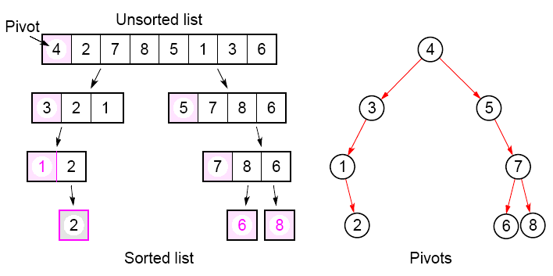
With the pivot being withheld in processes:
Slides for Parallel Programming Techniques & Applications Using Networked Workstations & Parallel Computers 2nd ed., by B. Wilkinson & M. Allen, @ 2004 Pearson Education Inc. All rights reserved.

Slide 31
Analysis
Fundamental problem with all tree constructions – initial division done by a single processor, which will seriously limit speed.
Tree in quicksort will not, in general, be perfectly balanced Pivot selection very important to make quicksort operate fast.
Slides for Parallel Programming Techniques & Applications Using Networked Workstations & Parallel Computers 2nd ed., by B. Wilkinson & M. Allen, @ 2004 Pearson Education Inc. All rights reserved.

Slide 32
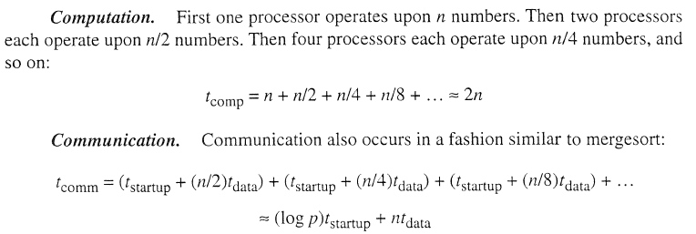
Slides for Parallel Programming Techniques & Applications Using Networked Workstations & Parallel Computers 2nd ed., by B. Wilkinson & M. Allen, @ 2004 Pearson Education Inc. All rights reserved.

Slide 33
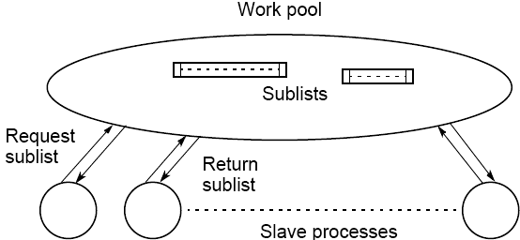
Work Pool Implementation of Quicksort
First, work pool holds initial unsorted list. Given to first processor which divides list into two parts. One part returned to work pool to be given to another processor, while the other part operated upon again.
Slides for Parallel Programming Techniques & Applications Using Networked Workstations & Parallel Computers 2nd ed., by B. Wilkinson & M. Allen, @ 2004 Pearson Education Inc. All rights reserved.

Slide 34
Neither Mergesort nor Quicksort parallelize very well as the
processor efficiency is low (see book for analysis).
Quicksort also can be very unbalanced. Can use load balancing techniques.
Slides for Parallel Programming Techniques & Applications Using Networked Workstations & Parallel Computers 2nd ed., by B. Wilkinson & M. Allen, @ 2004 Pearson Education Inc. All rights reserved.

Slide 35
Batcher’s Parallel Sorting Algorithms
• Odd-even Mergesort
• Bitonic Mergesort
Originally derived in terms of switching networks.
Both are well balanced and have parallel time complexity of O(log²n) with n processors.
Slides for Parallel Programming Techniques & Applications Using Networked Workstations & Parallel Computers 2nd ed., by B. Wilkinson & M. Allen, @ 2004 Pearson Education Inc. All rights reserved.

Slide 36
Odd-Even Mergesort
Odd-Even Merge Algorithm
Start with odd-even merge algorithm which will merge two sorted lists into one sorted list. Given two sorted lists a₁, a₂, a₃, …, a_{n} and b₁, b₂, b₃, …, b_{n} (where n is a power of 2).
Slides for Parallel Programming Techniques & Applications Using Networked Workstations & Parallel Computers 2nd ed., by B. Wilkinson & M. Allen, @ 2004 Pearson Education Inc. All rights reserved.

Slide 37
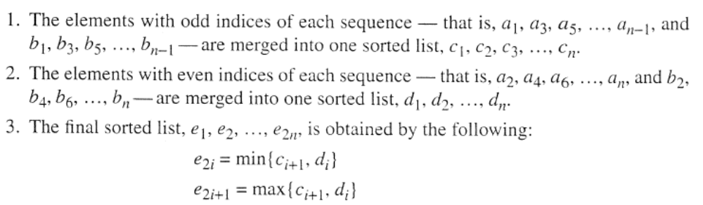
Slides for Parallel Programming Techniques & Applications Using Networked Workstations & Parallel Computers 2nd ed., by B. Wilkinson & M. Allen, @ 2004 Pearson Education Inc. All rights reserved.

Slide 38
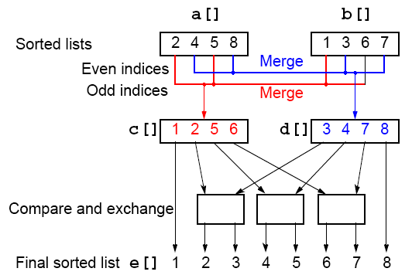
Odd-Even Merging of Two Sorted Lists
Slides for Parallel Programming Techniques & Applications Using Networked Workstations & Parallel Computers 2nd ed., by B. Wilkinson & M. Allen, @ 2004 Pearson Education Inc. All rights reserved.

Slide 39
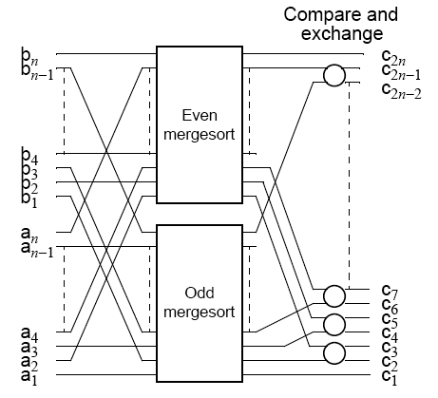
Odd-Even Mergesort
Apply odd-even merging recursively
Slides for Parallel Programming Techniques & Applications Using Networked Workstations & Parallel Computers 2nd ed., by B. Wilkinson & M. Allen, @ 2004 Pearson Education Inc. All rights reserved.

Slide 40
Bitonic Mergesort
Bitonic Sequence
A monotonic increasing sequence is a sequence of increasing numbers.
A bitonic sequence has two sequences, one increasing and one decreasing. e.g.
a₀ < a₁ < a₂, a₃, …, a_{i-1} < a_{i} > a_{i+1}, …, a_{n-2} > a_{n-1}
for some value of i (0 <= i < n).
A sequence is also bitonic if the preceding can be achieved by shifting the numbers cyclically (left or right).
Slides for Parallel Programming Techniques & Applications Using Networked Workstations & Parallel Computers 2nd ed., by B. Wilkinson & M. Allen, @ 2004 Pearson Education Inc. All rights reserved.

Slide 41
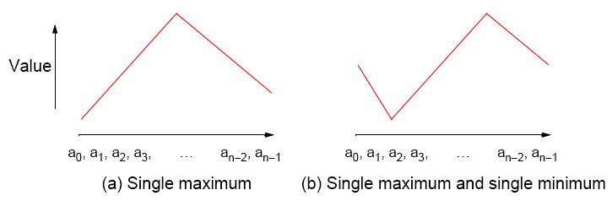
Bitonic Sequences
Slides for Parallel Programming Techniques & Applications Using Networked Workstations & Parallel Computers 2nd ed., by B. Wilkinson & M. Allen, @ 2004 Pearson Education Inc. All rights reserved.

Slide 42
“Special” Characteristic of Bitonic Sequences
If we perform a compare-and-exchange operation on a_{i} with a_{i+n/2} for all i, where there are n numbers in the sequence, get TWO bitonic sequences, where the numbers in one sequence are all less than the numbers in the other sequence.
Slides for Parallel Programming Techniques & Applications Using Networked Workstations & Parallel Computers 2nd ed., by B. Wilkinson & M. Allen, @ 2004 Pearson Education Inc. All rights reserved.

Slide 43
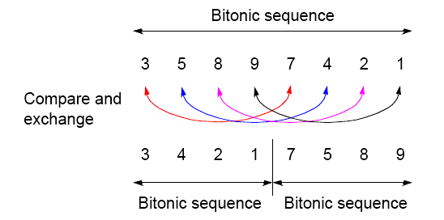
Creating two bitonic sequences from one bitonic sequence
Starting with the bitonic sequence
3, 5, 8, 9, 7, 4, 2, 1
we get:
Slides for Parallel Programming Techniques & Applications Using Networked Workstations & Parallel Computers 2nd ed., by B. Wilkinson & M. Allen, @ 2004 Pearson Education Inc. All rights reserved.

Slide 44
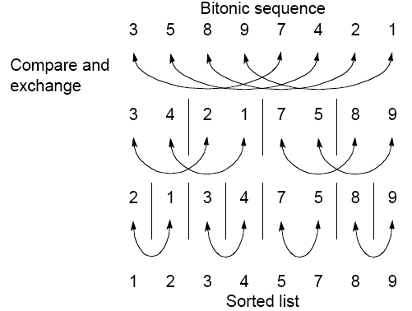
Sorting a bitonic sequence
Compare-and-exchange moves smaller numbers of each pair to left and larger numbers of pair to right. Given a bitonic sequence, recursively performing operations will sort the list.
Slides for Parallel Programming Techniques & Applications Using Networked Workstations & Parallel Computers 2nd ed., by B. Wilkinson & M. Allen, @ 2004 Pearson Education Inc. All rights reserved.

Slide 45
Sorting
To sort an unordered sequence, sequences are merged into larger bitonic sequences, starting with pairs of adjacent numbers.
By a compare-and-exchange operation, pairs of adjacent numbers formed into increasing sequences and decreasing sequences. Pairs form a bitonic sequence of twice size of each original sequences.
By repeating this process, bitonic sequences of larger and larger lengths obtained.
In the final step, a single bitonic sequence sorted into a single increasing sequence.
Slides for Parallel Programming Techniques & Applications Using Networked Workstations & Parallel Computers 2nd ed., by B. Wilkinson & M. Allen, @ 2004 Pearson Education Inc. All rights reserved.

Slide 46
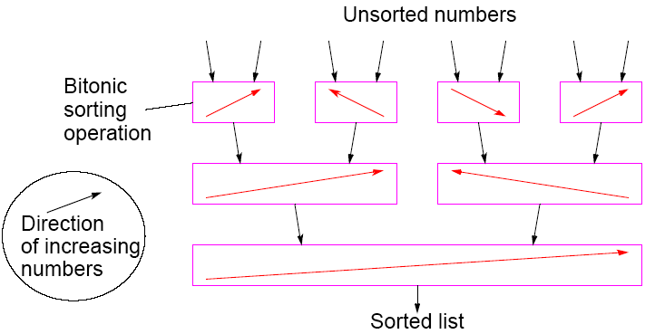
Bitonic Mergesort
Slides for Parallel Programming Techniques & Applications Using Networked Workstations & Parallel Computers 2nd ed., by B. Wilkinson & M. Allen, @ 2004 Pearson Education Inc. All rights reserved.

Slide 47
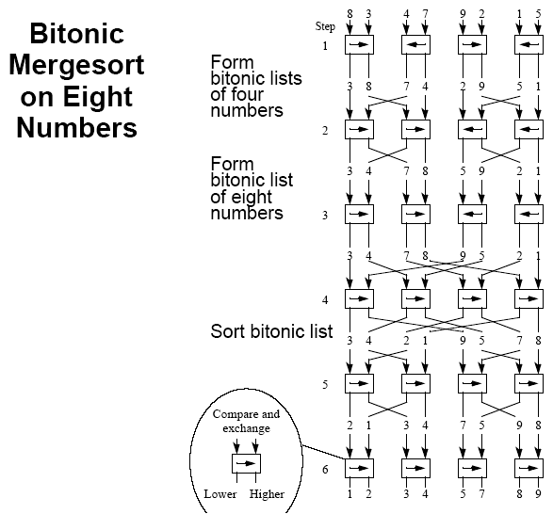
Slides for Parallel Programming Techniques & Applications Using Networked Workstations & Parallel Computers 2nd ed., by B. Wilkinson & M. Allen, @ 2004 Pearson Education Inc. All rights reserved.

Slide 48
Phases
The six steps (for eight numbers) are divided into three phases:
Phase 1 (Step 1) Convert pairs of numbers into increasing/
decreasing sequences and into 4-bit
bitonic sequences.
Phase 2 (Steps 2/3) Split each 4-bit bitonic sequence into two
2-bit bitonic sequences, higher
sequences at center.
Sort each 4-bit bitonic sequence increasing/ decreasing sequences and merge into 8-bit bitonic sequence.
Phase 3 (Steps 4/5/6)Sort 8-bit bitonic sequence.
Slides for Parallel Programming Techniques & Applications Using Networked Workstations & Parallel Computers 2nd ed., by B. Wilkinson & M. Allen, @ 2004 Pearson Education Inc. All rights reserved.

Slide 49

Number of Steps
In general, with n = 2^{k}, there are k phases, each of 1, 2, 3, …, k steps. Hence the total number of steps is given by
Slides for Parallel Programming Techniques & Applications Using Networked Workstations & Parallel Computers 2nd ed., by B. Wilkinson & M. Allen, @ 2004 Pearson Education Inc. All rights reserved.

Slide 50
Sorting Conclusions so far
Computational time complexity using n processors
• Odd-even transposition sort - O(n)
• Parallel mergesort - O(n) but unbalanced processor load and Communication
• Parallel quicksort - O(n) but unbalanced processor load, and communication can generate to O(n²)
• Odd-even Mergesort and Bitonic Mergesort O(log²n)
Bitonic mergesort has been a popular choice for a parallel sorting.
Slides for Parallel Programming Techniques & Applications Using Networked Workstations & Parallel Computers 2nd ed., by B. Wilkinson & M. Allen, @ 2004 Pearson Education Inc. All rights reserved.

Slide 51
Sorting on Specific Networks
Algorithms can take advantage of the underlying interconnection network of the parallel computer.
Two network structures have received specific attention: the mesh and hypercube because parallel computers have been built with these networks.
Of less interest nowadays because underlying architecture often hidden from user - We will describe a couple of representative algorithms.
MPI features for mapping algorithms onto meshes, and one can always use a mesh or hypercube algorithm even if the underlying architecture is not the same.
Slides for Parallel Programming Techniques & Applications Using Networked Workstations & Parallel Computers 2nd ed., by B. Wilkinson & M. Allen, @ 2004 Pearson Education Inc. All rights reserved.

Slide 52
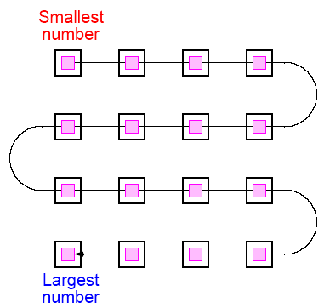
Mesh - Two-Dimensional Sorting
The layout of a sorted sequence on a mesh could be row by row or snakelike. Snakelike:
Slides for Parallel Programming Techniques & Applications Using Networked Workstations & Parallel Computers 2nd ed., by B. Wilkinson & M. Allen, @ 2004 Pearson Education Inc. All rights reserved.

Slide 53
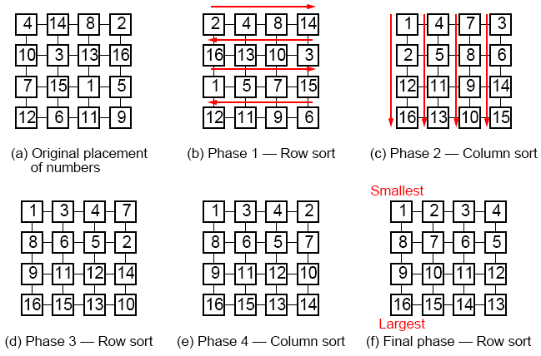
Shearsort
Alternate row and column sorting until list fully sorted. Row sorting
alternative directions to get snake-like sorting:
Slides for Parallel Programming Techniques & Applications Using Networked Workstations & Parallel Computers 2nd ed., by B. Wilkinson & M. Allen, @ 2004 Pearson Education Inc. All rights reserved.

Slide 54
Shearsort
Slides for Parallel Programming Techniques & Applications Using Networked Workstations & Parallel Computers 2nd ed., by B. Wilkinson & M. Allen, @ 2004 Pearson Education Inc. All rights reserved.

Slide 55
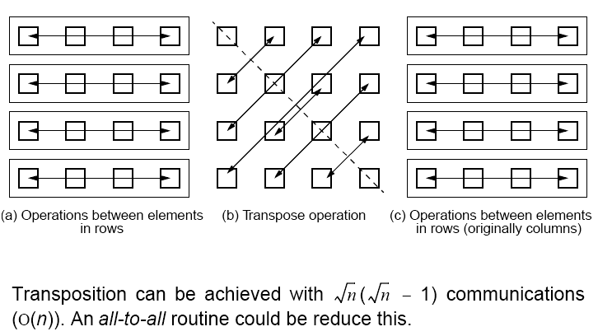
Using Transposition
Causes the elements in each column to be in positions in a row.
Can be placed between the row operations and column operations
Slides for Parallel Programming Techniques & Applications Using Networked Workstations & Parallel Computers 2nd ed., by B. Wilkinson & M. Allen, @ 2004 Pearson Education Inc. All rights reserved.

Slide 56
Hypercube
Quicksort
Hypercube network has structural characteristics that offer scope for implementing efficient divide-and-conquer sorting algorithms, such as quicksort.
Slides for Parallel Programming Techniques & Applications Using Networked Workstations & Parallel Computers 2nd ed., by B. Wilkinson & M. Allen, @ 2004 Pearson Education Inc. All rights reserved.

Slide 57
Complete List Placed in One Processor
Suppose a list of n numbers placed on one node of a d-dimensional hypercube.
List can be divided into two parts according to the quicksort algorithm by using a pivot determined by the processor, with one part sent to the adjacent node in the highest dimension.
Then the two nodes can repeat the process.
Slides for Parallel Programming Techniques & Applications Using Networked Workstations & Parallel Computers 2nd ed., by B. Wilkinson & M. Allen, @ 2004 Pearson Education Inc. All rights reserved.

Slide 58
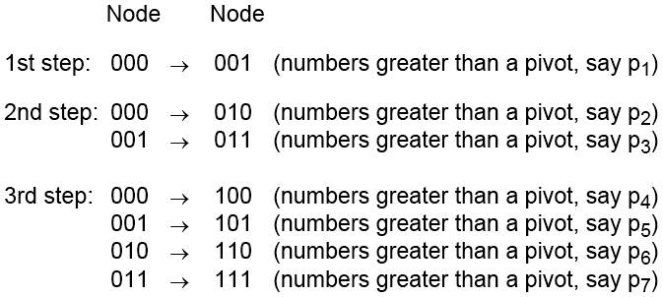
Example
3-dimensional hypercube with the numbers originally in node 000:
Finally, the parts sorted using a sequential algorithm, all in parallel. If required, sorted parts can be returned to one processor in a sequence that allows processor to concatenate sorted lists to create final sorted list.
Slides for Parallel Programming Techniques & Applications Using Networked Workstations & Parallel Computers 2nd ed., by B. Wilkinson & M. Allen, @ 2004 Pearson Education Inc. All rights reserved.

Slide 59
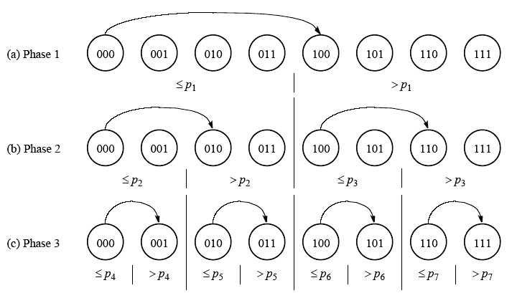
Hypercube quicksort algorithm
- numbers originally in node 000
Slides for Parallel Programming Techniques & Applications Using Networked Workstations & Parallel Computers 2nd ed., by B. Wilkinson & M. Allen, @ 2004 Pearson Education Inc. All rights reserved.

Slide 60
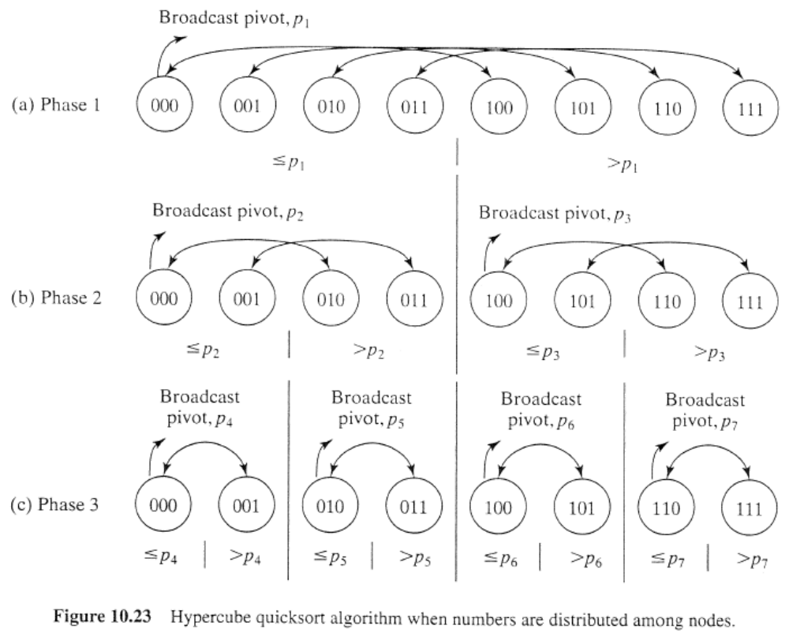
Numbers Initially Distributed Across All Processors
Slides for Parallel Programming Techniques & Applications Using Networked Workstations & Parallel Computers 2nd ed., by B. Wilkinson & M. Allen, @ 2004 Pearson Education Inc. All rights reserved.

Slide 61
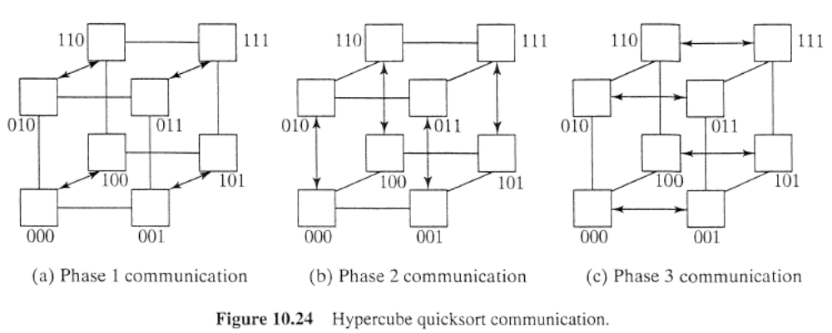
Slides for Parallel Programming Techniques & Applications Using Networked Workstations & Parallel Computers 2nd ed., by B. Wilkinson & M. Allen, @ 2004 Pearson Education Inc. All rights reserved.

Slide 62
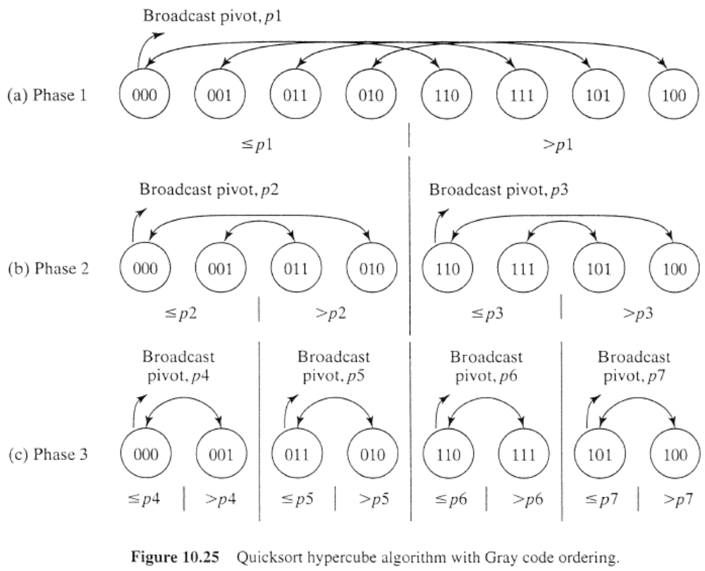
Slides for Parallel Programming Techniques & Applications Using Networked Workstations & Parallel Computers 2nd ed., by B. Wilkinson & M. Allen, @ 2004 Pearson Education Inc. All rights reserved.

Slide 63
Other Sorting Algorithms
We began by giving the lower bound for the time complexity of a sequential sorting algorithm based upon comparisons as O(nlogn).
Consequently, the time complexity of a parallel sorting algorithm based upon comparisons is O((nlogn)/p) with p processors or O(logn) with n processors.
There are sorting algorithms that can achieve better than O(nlogn) sequential time complexity and are very attractive candidates for parallelization but they often assume special properties of the numbers being sorted.
Slides for Parallel Programming Techniques & Applications Using Networked Workstations & Parallel Computers 2nd ed., by B. Wilkinson & M. Allen, @ 2004 Pearson Education Inc. All rights reserved.

Slide 64
Rank Sort as basis of a parallel sorting algorithm
Does not achieve a sequential time of O(nlogn), but can be parallelized easily, and leads us onto linear sequential time algorithms which can be parallelized to achieve O(logn) parallel time and are attractive algorithms for clusters.
Slides for Parallel Programming Techniques & Applications Using Networked Workstations & Parallel Computers 2nd ed., by B. Wilkinson & M. Allen, @ 2004 Pearson Education Inc. All rights reserved.

Slide 65
Rank Sort
Number of numbers that are smaller than each selected number counted. This count provides the position of selected number in sorted list; that is, its “rank.”
First a[0] is read and compared with each of the other numbers, a[1] … a[n-1], recording the number of numbers less than a[0].
Suppose this number is x. This is the index of the location in the final sorted list.
The number a[0] is copied into the final sorted list b[0] … b[n-1], at location b[x]. Actions repeated with the other numbers.
Overall sequential sorting time complexity of O(n²) (not exactly a good sequential sorting algorithm!).
Slides for Parallel Programming Techniques & Applications Using Networked Workstations & Parallel Computers 2nd ed., by B. Wilkinson & M. Allen, @ 2004 Pearson Education Inc. All rights reserved.

Slide 66
Sequential Code
for (i = 0; i < n; i++) { /* for each number */
x = 0;
for (j = 0; j < n; j++) /* count number less than it */
if (a[i] > a[j]) x++;
b[x] = a[i]; /* copy number into correct place */
}
This code will fail if duplicates exist in the sequence of numbers. Easy to fix. (How?)
Slides for Parallel Programming Techniques & Applications Using Networked Workstations & Parallel Computers 2nd ed., by B. Wilkinson & M. Allen, @ 2004 Pearson Education Inc. All rights reserved.

Slide 67
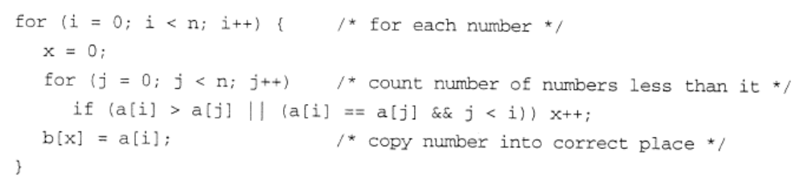
Slides for Parallel Programming Techniques & Applications Using Networked Workstations & Parallel Computers 2nd ed., by B. Wilkinson & M. Allen, @ 2004 Pearson Education Inc. All rights reserved.

Slide 68
Parallel Code
Using n Processors
One processor allocated to each number. Finds final index in O(n) steps. With all processors operating in parallel, parallel time complexity O(n).
In forall notation, the code would look like
forall (i = 0; i < n; i++) { /* for each no in parallel*/
x = 0;
for (j = 0; j < n; j++) /* count number less than it */
if (a[i] > a[j]) x++;
b[x] = a[i]; /* copy no into correct place */
}
Parallel time complexity, O(n), as good as any sorting algorithm so far. Can do even better if we have more processors.
Slides for Parallel Programming Techniques & Applications Using Networked Workstations & Parallel Computers 2nd ed., by B. Wilkinson & M. Allen, @ 2004 Pearson Education Inc. All rights reserved.

Slide 69
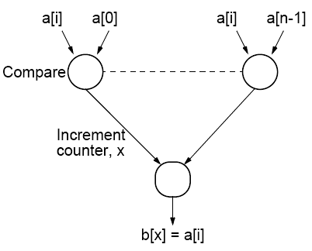
Using n² Processors
Comparing one number with the other numbers in list using multiple processors:
n - 1 processors used to find rank of one number. With n numbers, (n - 1)n processors or (almost) n² processors needed. Incrementing counter done sequentially and requires maximum of n steps. Total number of steps = 1 + n.
Slides for Parallel Programming Techniques & Applications Using Networked Workstations & Parallel Computers 2nd ed., by B. Wilkinson & M. Allen, @ 2004 Pearson Education Inc. All rights reserved.

Slide 70
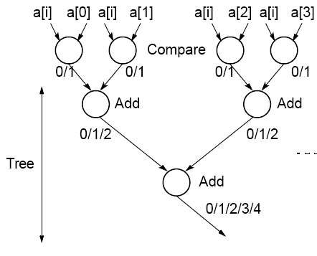
Reduction in Number of Steps
Tree to reduce number of steps involved in incrementing counter:
O(logn) algorithm with n² processors.
Processor efficiency relatively low.
Slides for Parallel Programming Techniques & Applications Using Networked Workstations & Parallel Computers 2nd ed., by B. Wilkinson & M. Allen, @ 2004 Pearson Education Inc. All rights reserved.

Slide 71
Parallel Rank Sort Conclusions
Easy to do as each number can be considered in isolation.
Rank sort can sort in:
O(n) with n processors
or
O(logn) using n² processors.
In practical applications, using n² processors prohibitive.
Theoretically possible to reduce time complexity to O(1) by
considering all increment operations as happening in parallel since they are independent of each other.
Slides for Parallel Programming Techniques & Applications Using Networked Workstations & Parallel Computers 2nd ed., by B. Wilkinson & M. Allen, @ 2004 Pearson Education Inc. All rights reserved.

Slide 72
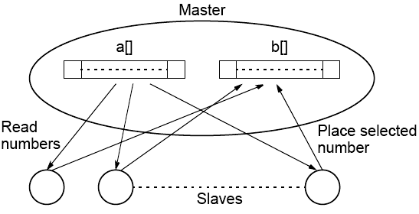
Message Passing Parallel Rank Sort
Master-Slave Approach
Requires shared access to list of numbers. Master process responds to request for numbers from slaves. Algorithm better for shared memory
Slides for Parallel Programming Techniques & Applications Using Networked Workstations & Parallel Computers 2nd ed., by B. Wilkinson & M. Allen, @ 2004 Pearson Education Inc. All rights reserved.

Slide 73
Counting Sort
If the numbers to be sorted are integers, there is a way of coding the rank sort algorithm to reduce the sequential time complexity from O(n²) to O(n), called as Counting Sort.
As in the rank sort code suppose the unsorted numbers stored in an array a[] and final sorted sequence is stored in array b[]. Algorithm uses an additional array, say c[], having one element for each possible value of the numbers. Suppose the range of integers is from 1 to m. The array has element c[1] through c[m] inclusive. Now, let us working through the algorithm in stages.
Slides for Parallel Programming Techniques & Applications Using Networked Workstations & Parallel Computers 2nd ed., by B. Wilkinson & M. Allen, @ 2004 Pearson Education Inc. All rights reserved.

Slide 74
Stable Sort Algorithms
Algorithms that will place identical numbers in the same order as in the original sequence.
Counting sort is naturally a stable sorting algorithm. (duplicate numbers)
Slides for Parallel Programming Techniques & Applications Using Networked Workstations & Parallel Computers 2nd ed., by B. Wilkinson & M. Allen, @ 2004 Pearson Education Inc. All rights reserved.

Slide 75
First, c[ ] will be used to hold the histogram of the sequence, that is, the number of each number. This can be computed in O(m) time with code such as:
for (i = 1; i <= m; i++)
c[i] = 0;
for (i = 1; i <= m; i++)
c[a[i]]++;
Slides for Parallel Programming Techniques & Applications Using Networked Workstations & Parallel Computers 2nd ed., by B. Wilkinson & M. Allen, @ 2004 Pearson Education Inc. All rights reserved.

Slide 76
Next stage: The number of numbers less than each number found by performing a prefix sum operation on array c[ ].
In the prefix sum calculation, given a list of numbers, x₀, …, x_{n-1}, all the partial summations (i.e., x₀; x₀ + x₁; x₀ + x₁ + x₂; x₀ + x₁ + x₂ + x₃; … ) are computed.
Here, the prefix sum is computed using the histogram originally held in c[ ] in O(m) time as described below:
for (i = 2; i <= m; i++)
c[i] = c[i] + c[i-1];
Slides for Parallel Programming Techniques & Applications Using Networked Workstations & Parallel Computers 2nd ed., by B. Wilkinson & M. Allen, @ 2004 Pearson Education Inc. All rights reserved.

Slide 77
Final stage: The numbers are placed in the sorted order in O(n) time as described below:
for (i = n; i >= 1; i--) {
b[c[a[i]]] = a[i]
c[a[i]]--; /* ensures stable sorting */
}
Complete code has O(n + m) sequential time complexity. If m is linearly related to n as it is in some applications, the code has O(n) sequential time complexity.
Slides for Parallel Programming Techniques & Applications Using Networked Workstations & Parallel Computers 2nd ed., by B. Wilkinson & M. Allen, @ 2004 Pearson Education Inc. All rights reserved.

Slide 78
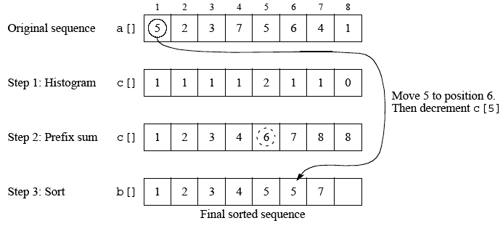
Counting sort
Slides for Parallel Programming Techniques & Applications Using Networked Workstations & Parallel Computers 2nd ed., by B. Wilkinson & M. Allen, @ 2004 Pearson Education Inc. All rights reserved.

Slide 79
Parallelizing counting sort can use the parallel version of the prefix sum calculation which requires O(logn) time with n - 1 processors.
The final sorting stage can be achieved in O(n/p) time with p processors or O(1) with n processors by simply having the body of the loop done by different processors.
Slides for Parallel Programming Techniques & Applications Using Networked Workstations & Parallel Computers 2nd ed., by B. Wilkinson & M. Allen, @ 2004 Pearson Education Inc. All rights reserved.

Slide 80
Radix Sort
Assumes numbers to sort are represented in a positional digit representation such as binary and decimal numbers. The digits represent values and position of each digit indicates their relative weighting.
Radix sort starts at the least significant digit and sorts the numbers according to their least significant digits. The sequence is then sorted according to the next least significant digit and so on until the most significant digit, after which the sequence is sorted. For this to work, it is necessary that the order of numbers with the same digit is maintained, that is, one must use a stable sorting algorithm.
Slides for Parallel Programming Techniques & Applications Using Networked Workstations & Parallel Computers 2nd ed., by B. Wilkinson & M. Allen, @ 2004 Pearson Education Inc. All rights reserved.

Slide 81
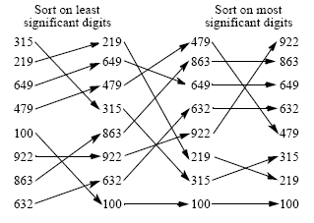
Radix sort using decimal digits
Slides for Parallel Programming Techniques & Applications Using Networked Workstations & Parallel Computers 2nd ed., by B. Wilkinson & M. Allen, @ 2004 Pearson Education Inc. All rights reserved.

Slide 82
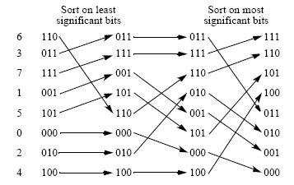
Radix sort using binary digits
Slides for Parallel Programming Techniques & Applications Using Networked Workstations & Parallel Computers 2nd ed., by B. Wilkinson & M. Allen, @ 2004 Pearson Education Inc. All rights reserved.

Slide 83
Radix sort can be parallelized by using a parallel sorting algorithm in each phase of sorting on bits or groups of bits.
Already mentioned parallelized counting sort using prefix sum calculation, which leads to O(logn) time with n - 1 processors and constant b and r.
Slides for Parallel Programming Techniques & Applications Using Networked Workstations & Parallel Computers 2nd ed., by B. Wilkinson & M. Allen, @ 2004 Pearson Education Inc. All rights reserved.

Slide 84
Example of parallelizing radix sort sorting on binary digits
Can use prefix-sum calculation for positioning each number at each stage. When prefix sum calculation applied to a column of bits, it gives number of 1’s up to each digit position because all digits can only be 0 or 1 and prefix calculation will simply add number of 1’s.
A second prefix calculation can also give the number of 0’s up to each digit position by performing the prefix calculation on the digits inverted (diminished prefix sum).
When digit considered being a 0, diminished prefix sum calculation provides new position for number.
When digit considered being a 1, result of normal prefix sum calculation plus largest diminished prefix calculation gives final position for number.
Slides for Parallel Programming Techniques & Applications Using Networked Workstations & Parallel Computers 2nd ed., by B. Wilkinson & M. Allen, @ 2004 Pearson Education Inc. All rights reserved.

Slide 85
Sorting Algorithms on Clusters
Factors for efficient implementation on clusters:
Using collective operations such broadcast, gather, scatter, and reduce provided in message-passing software such as MPI rather than non-uniform communication patterns that require point-to-point communication, because collective operations expected to be implemented efficiently.
Distributed memory of a cluster does not favor algorithms requiring access to widely separately numbers. Algorithms that require only local operations are better, although all sorting algorithms finally have to move numbers in the worst case from one end of sequence to other somehow.
Slides for Parallel Programming Techniques & Applications Using Networked Workstations & Parallel Computers 2nd ed., by B. Wilkinson & M. Allen, @ 2004 Pearson Education Inc. All rights reserved.

Slide 86
Cache memory -- better to have an algorithm that operate upon a block of numbers that can be placed in the cache. Will need to know the size and organization of the cache, and this has to become part of thealgorithm as parameters.
Clusters of SMP processors (SMP clusters) -- algorithms need to take into account that the groups of processors in each SMP system may operate in the shared memory mode where the shared memory is only within each SMP system, whereas each system may communicate with other SMP systems in the cluster in a message-passing mode. Again to take this into account requires parameters such as number of processors within each SMP system and size of the memory in each SMP system.
Slides for Parallel Programming Techniques & Applications Using Networked Workstations & Parallel Computers 2nd ed., by B. Wilkinson & M. Allen, @ 2004 Pearson Education Inc. All rights reserved.

